Slide 1
Biomass Plant Modeling by Dara T, Marisol A, Jarrell B, Tanya H
MATH 430

Slide 2
Introduction

Slide 3
Background
The objective of this project was to develop a mathematical model that shows how plant communities are affected by different conditions, including weather patterns and whether one or multiple species is more beneficial.
Our team considered different options; such as drought conditions in specific areas of the US, other countries, or just general weather conditions. We chose to look at drought effects on single species crops versus crops with companion plants. We used corn as our main crop and Minnesota weather information.
Our model analyzes how precipitation affects crops and whether companion plants help to increase overall biomass or if they create competition and decrease biomass.

Slide 4
How We Chose to Approach Problem Pt. 1
Research - initial stage
Broad research – plant modeling, biomass, drought impact on crops - not very targeted research but rather absorbing information.
Research specific areas of interest for drought investigation ex:
Jarrell – South American country
Dara – Minnesota
Marisol – CO, AZ
Tanya – European country
Choosing a location
Picked MN to focus further research
Researched crops grown in MN
Researched weather conditions in past seasons

Slide 5
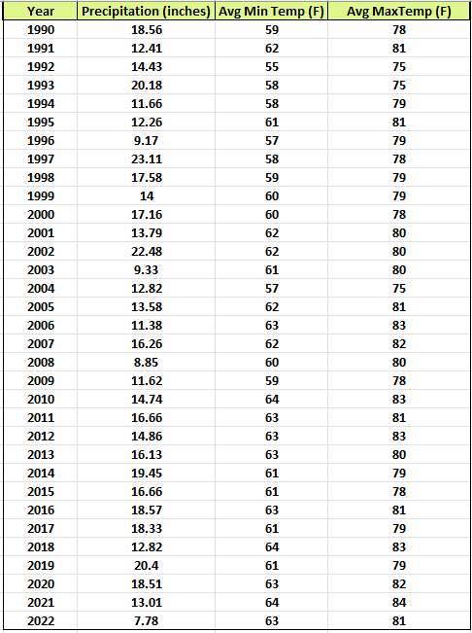

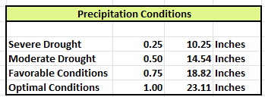
Weather
We gathered Minnesota weather information for the past 33 years. Our data included daily precipitation along with high and low temperatures. Used information as a flexible guide to model weather conditions.
2023 was not included as the full year of data was not yet available.

Slide 6
How We Chose to Approach Problem Pt. 2
Pick a crop
Picked corn as main subject of study
Gathered information on corn growing conditions
Research on companion plants to corn
Initialize work and refining model
Divided work into smaller goals
Calculation of biomass
Research any specific pertinent information missing
Working on math model equations
Translating into code
Writing the technical report

Slide 7
Initial Model Components
Weather
Daily precipitation and temperatures
Germination
Length of germination period and plant mortality
Growing Season
Environmental impacts of precipitation, temperature, and companion plants
Biomass Calculation
Resultant biomass

Slide 8
Why Use Companion Crops?
Companion planting is planting compatible crops together so that the crops benefit from growing together. A few of the plants that are compatible with corn are beans, winter squash, and mint.
Some benefits of companion planting:
Companion plants such as marigolds repel insect pests.
Certain types of companion plants feed nitrogen back into the soil, improving nourishment to the main crop.
Some companion plants release specific chemicals that increase growth rates.

Slide 9
Methods

Slide 10
Methods
Python programming was chosen to represent our model and simulate differing weather conditions. Python allows for conditional statements and other powerful tools to:
Represent different constants
Number of simulations
List sizes
Randomize values
Temperature
Precipitation
Kernel loss
Create and store lists
Run statistical analysis on lists to extract meaningful data

Slide 11

Coding Standards
Tools used
Python programming language
Packages imported:
pandas
numpy
matplotlib
random
math
scipy.stats
statistics
holoviews
Google colab for code sharing

Slide 12
General Assumptions for Model
Soil conditions are uniform
Includes nitrogen, pH level
No irrigation
No fertilizers
No pests
No disease
No competition for resources
Ignores specific management practices
Assumed values for companion plant impact

Slide 13
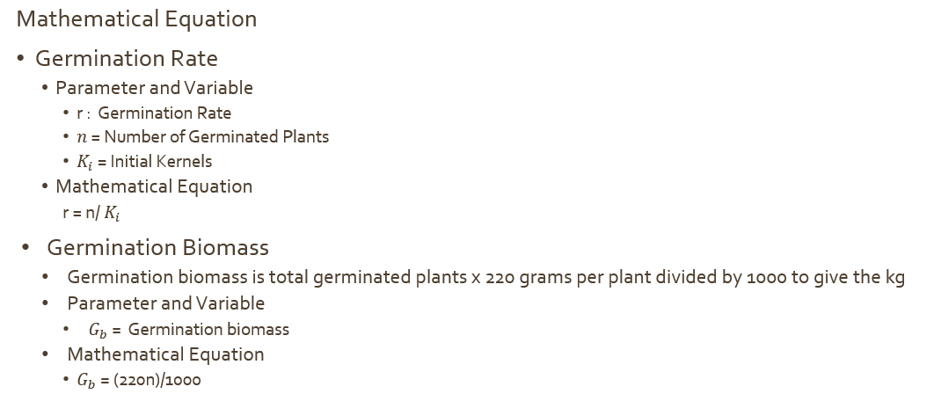
Germination Mathematical Equations

Slide 14
Germination Parameters
Determined germination season and plant mortality.
Kernel loss index = 0.06.
Minimum acceptable soil precipitation = 0.08
Initial kernels = 1000 (corn kernels / acre)
Germination Process Assumptions:
Temperatures and precipitation calculated for daily basis using values for harvest season averaging 80 days.
Kernel loss is an exponential distribution
Soil temperature and soil precipitation is uniform distribution
Germination period is randomized between 7 and 21 days.
Biomass at the end of germination period used to begin growing season calculations.

Slide 15
General Code Process
Step 1 New trial begins
Step 3 Germination: which kernels survive the culling
Step 4 Season occurs and biomass calculated
Step 2 Randomize weather conditions for germination
Step 5 A trial concludes and aggregates data

Slide 16





General Code Process
Step 1 New trial begins
Step 3 Germination: which kernels survive the culling
Step 4 Season occurs and biomass calculated
Step 2 Randomize weather conditions for germination
Step 5 A trial concludes and aggregates data

Slide 17
Germination conditions for randomization
Condition | Lower bound Temp | Upper bound Temp | Lower bound Precip | Higher bound Precip | Temp factor | Precip factor
Late frost | 50 | 70 | .05 | .1 | .8 | .8
Severe drought | 60 | 110 | .04 | .12 | .9 | .6
Moderate Drought | 60 | 100 | .08 | .13 | .95 | .65
Optimal temps / low precip | 60 | 86.9 | .11 | .18 | .99 | .88
Optimal temps / precip | 60 | 86.9 | .175 | .225 | 1 | 1
High temps / high precip | 80 | 100 | .175 | .263 | .92 | .96
Flood | 60 | 100 | .175 | .313 | .95 | .46

Slide 18





General Code Process
Step 1 New trial begins
Step 3 Germination: which kernels survive the culling
Step 4 Season occurs and biomass calculated
Step 2 Randomize weather conditions for germination
Step 5 A trial concludes and aggregates data

Slide 19
Which Kernels Make it?
Initial kernels recalculated to account for endogenous reasons of kernel loss
Initial kernels * (1 – kernel loss index)
Germination check to decide whether initial basic conditions met by viable kernels
Initial soil temp greater than or equal to 55F
Median soil temp stays above 60F
Minimum threshold of .08" daily precipitation
Viable kernels go through a further calculation based on temperature factor and precipitation factor
Viable kernels * temperature factor * precipitation factor

Slide 20
Ex:
Moderate drought chosen through randomization
Initial soil temp = 70
Median soil temp = 80
Median soil precipitation = .1
Viable kernels that meet initial conditions go on to next check and would be multiplied by the temp factor of .95 and precipitation factor of .65
Those go on to the growing season

Slide 21




General Code Process
Step 1 New trial begins
Step 3 Germination: which kernels survive the culling
Step 4 Season occurs and biomass calculated
Step 2 Randomize weather conditions for germination
Step 5 A trial concludes and aggregates data

Slide 22
Growing Season
Simulated growing season conditions
Variable | Range | Unit | Notes
Grow Days | 60-100 | Days | Random
Temperature | 43 – 104 | F | Normal Random Distribution
Daily Precipitation | 0 – 4.13 | In | Uniform Random Distribution
Growing Temperature | 65-73 | F | N/A
Environment Impact | -0.2 - 0.1 | % | Negative Value shows positive impact

Slide 23
Daily Growth Calculation
Gemination/Previous Biomass
Environmental Factor
Competition Factor
Final Growth Factor
Final Biomass

Slide 24
Environmental Factor
4 main categories
Temperature lower than ideal growing temperature | Precipitation: None, Low, Ideal, High
Temperature higher than ideal growing temperature | Precipitation: None, Low, Ideal, High
Temperature Ideal | Precipitation: None, Low, High
Temperature and Precipitation Ideal

Slide 25
Competition Factor
A negative value represents a positive factor on growth (i.e. companion crop such as dill, squash, melon, etc.)
A positive value represents a negative factor on growth (i.e. competition crop such as a different variety of corn, tomatoes, etc.)

Slide 26

Calculations
If day one, then daily biomass is the biomass from germinated seeds
$$Growth Factor=\left(1 −environmental factor\right)∗\left(1−competition factor\right)$$
$$Daily Biomass=Previous day biomass ∗Growth factor$$

Slide 27





General Code Process
Step 1 New trial begins
Step 3 Germination: which kernels survive the culling
Step 4 Season occurs and biomass calculated
Step 2 Randomize weather conditions for germination
Step 5 A trial concludes and aggregates data

Slide 28
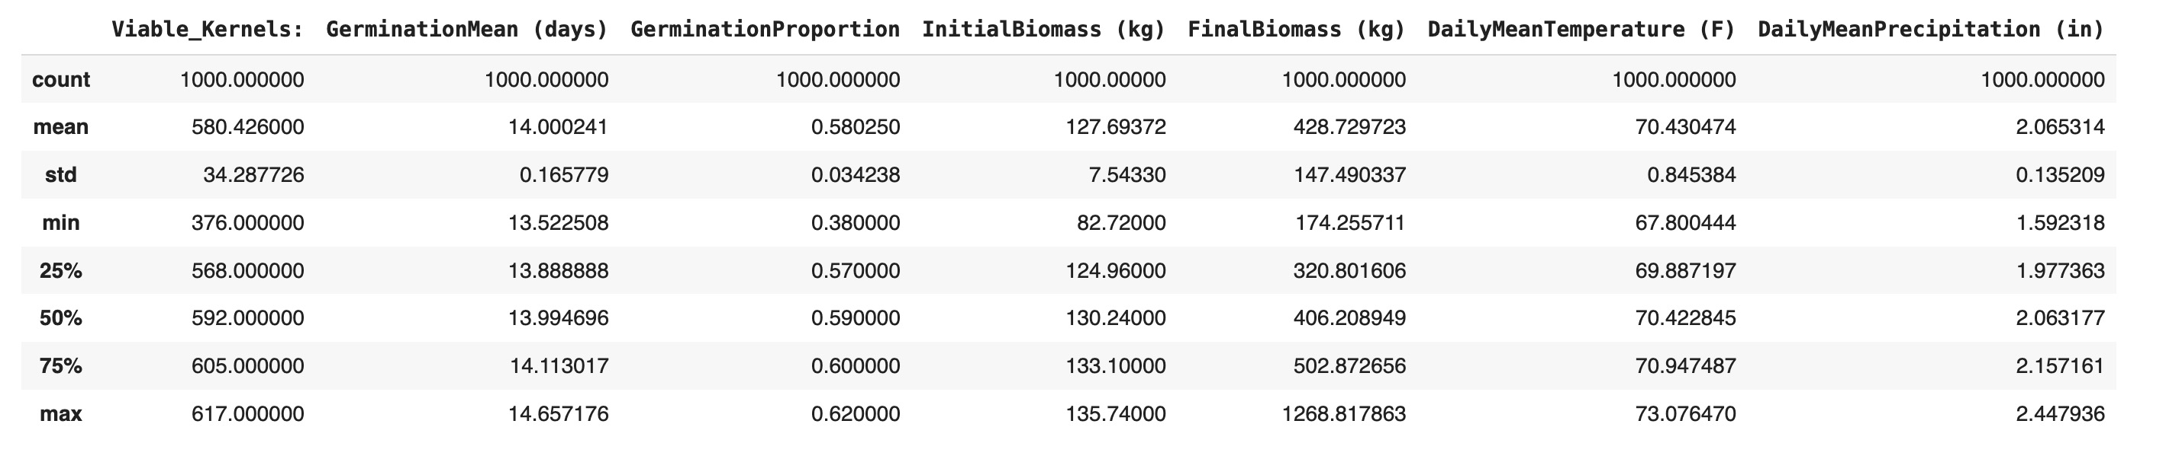
Aggregation and statistical analysis
After all simulation trials are run and aggregated to a list and dictionary, statistical analysis is called, and descriptive analytics are populated for the growing season.

Slide 29
Results

Slide 30
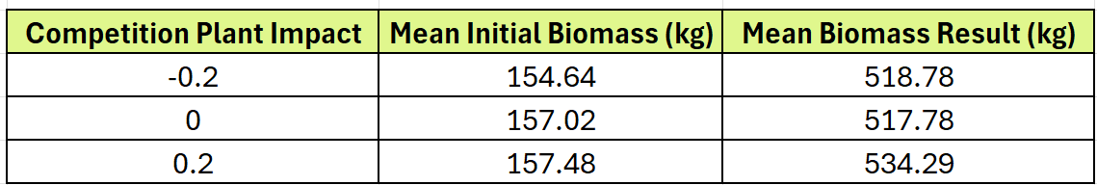
Analysis and Results
Companion plants with a negative impact resulted in a slightly higher biomass than having no companion plant.
Companion plants with a positive impact result in approximately 3% higher biomass than having no companion plant.

Slide 31
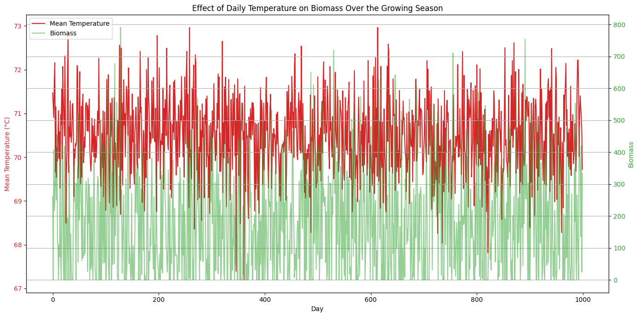

Slide 32
Conclusion

Slide 33
Objective
Our model analyzed how precipitation affects crops and whether companion plants help to increase overall biomass or if they create competition and decrease biomass.
Limitation and advantages:
Advantage: Competition impact levels could be fulfilled by different array of plants
Drawback: Without including specific variables of specific companion crops the model could be too generic.
Future directions
Find concrete values for different species to compare against one another / with how well they adapt in conjunction to corn
Scaling the project is possible, our simulation ran 1000 harvest seasons, but more could be performed.

Slide 34
Recommendations

Slide 35
Recommendations
Using companion plants that are compatible with main crops is recommended to improve biomass, in this case for corn those such as beans or squash. There are additional benefits, including improving soil conditions, repelling harmful pests, and attracting pollinators, depending on the plants that are used.
Avoid planting with crops known to have a negative impact. Conduct further research to decipher said crops.
Choose companion plants resistant to drought and /or flood
Choose corn varieties resistant to drought

